Slide 1


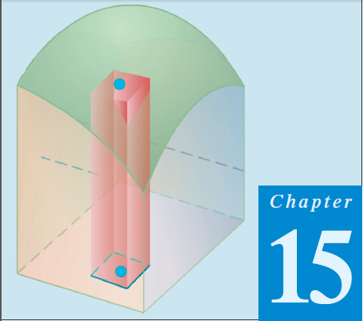
Thomas Calculus 11th
13
Changing Integral Variables
Samuel Lukas

Slide 2
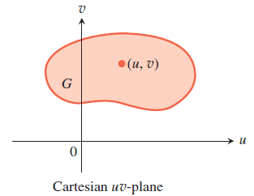

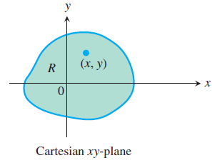

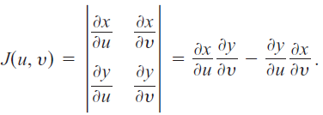
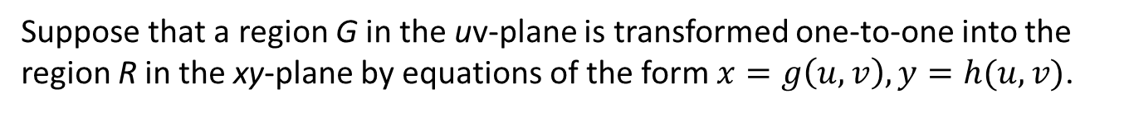
Substitutions in Multiple Integrals
Suppose that a region G in the uv-plane is transformed one-to-one into the region R in the xy-plane by equations of the form $x=g\left(u,v\right), y=h(u,v)$.

Slide 3
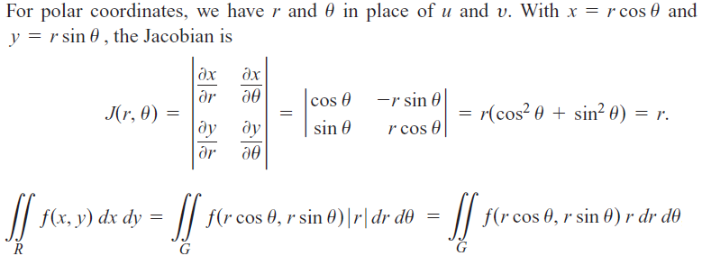

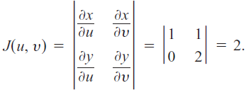

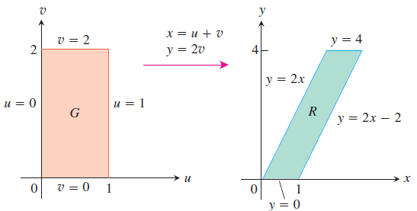


Evaluate :

Slide 4

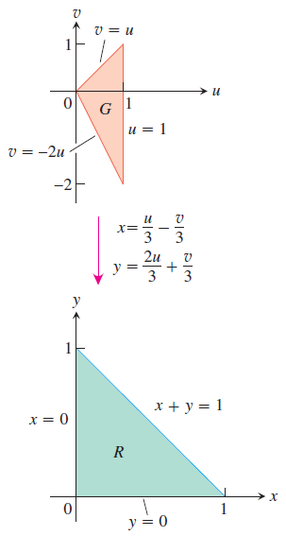

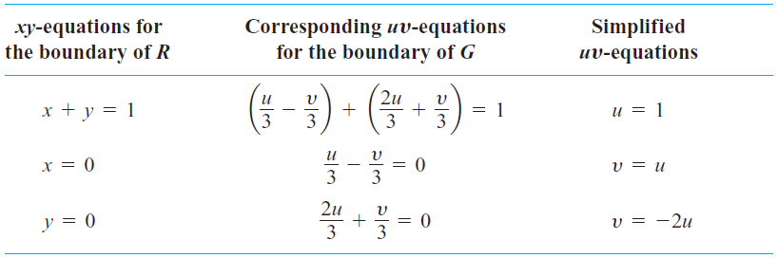
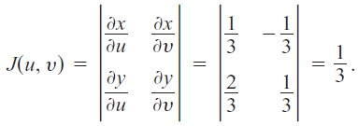


Evaluate :
= …

Slide 5






Exercises
Evaluate the integrals
01.
02.
03.
04.
05.

